Slide 1

PROJECT TITLE
Web Phishing Detection Using Machine Learning
FINAL EVALUATION
SUBMITTED BY: NAME : ADHITHYAN S COLLEGE : DHANALAKSHMI SRINIVASAN COLLEGE OF ENGINEERING COIMBATORE (COAPPS INTERNSHIP FINAL PROJECT)

Slide 2
CONTENTS
Introduction
Phishing Attacks: Overview and Statistics
Data Collection & Feature Extraction
Data Exploration and Analysis
Data Preprocessing
Model Training and Hyperparameter Tuning
Model Evaluation & Model Selection Process
Model Deployment and Interface Creation
Package and Library Utilization
Advantages and Disadvantages
Conclusion and Future Directions

Slide 3
INTRODUCTION
In today's digital age, the use of online services and activities has led to an increase in cyber threats, with phishing attacks being among the most prevalent and damaging. Phishing involves the use of deceptive tactics to trick individuals into Giving sensitive information such as login credentials, financial data, or personal details. So, there is a critical need for effective mechanisms to detect these malicious activities
Purpose of the Application:
I want to provide users with a dependable tool that can quickly detect potentially harmful websites, protecting their sensitive information from being compromised
Audience:
The audience includes both individuals and organizations who want to improve their online security and protect themselves from phishing scams

Slide 4
Phishing Attacks: Overview and Statistics
Phishing Attacks: Overview and Statistics:
Phishing attacks have proliferated in recent years, becoming increasingly sophisticated and pervasive.
According to statistics, millions of phishing attempts are made daily, resulting in substantial financial losses and data breaches.
Need for Phishing Detection Solutions:
Traditional methods of identifying phishing websites, such as blacklisting, have proven inadequate in combating evolving threats.
Machine learning presents a promising avenue for detecting phishing attacks by discerning subtle patterns and anomalies inherent in fraudulent websites.
Machine Learning in Phishing Detection:
By harnessing machine learning algorithms and training them on large datasets of known phishing and legitimate websites, we can equip them with the ability to recognize and classify suspicious activities effectively.

Slide 5
Data Collection
Data Collection Sources:
My dataset is sourced from Kaggle, a renowned platform for machine learning datasets, ensuring data quality and reliability.
Additionally, I complement my dataset by extracting features directly from URLs using web scraping techniques.
Utilizing Kaggle:
Kaggle provides a diverse range of datasets, including labeled phishing and legitimate website data, facilitating comprehensive model training.
The datasets on Kaggle offer valuable insights into website characteristics and behaviors, serving as a foundational resource for my project.
Web Scraping with BeautifulSoup:
To enrich the dataset and capture real-time website features, I used BeautifulSoup, a powerful web scraping library in Python.
BeautifulSoup enables to extract HTML elements, metadata, and textual content from web pages, enhancing the richness and relevance of the feature set.

Slide 6
Integration and Data Consistency:
By seamlessly integrating Kaggle datasets with web-scraped features, I ensure consistency and completeness in My dataset, enabling robust model training and evaluation.
The combined dataset encompasses a wide range of website attributes, empowering my ML models to learn and generalize effectively.

Slide 7
Exploratory Data Analysis (EDA)
Exploratory Data Analysis (EDA):
EDA helps to understand the distribution of the dataset, find correlations, and choose important features for training models. By using visualizations and statistical analysis, I found valuable patterns and trends that guide modeling decisions
Approach:
I used different EDA techniques like correlation analysis, distribution plots, and summary statistics to understand our dataset better.
Challenges and Solutions:
Challenges such as missing data, skewed distributions, and outliers are addressed through data imputation, transformation, and normalization, ensuring the reliability and accuracy of the analyses.

Slide 8
Data Preprocessing
Data Preprocessing:
Data preprocessing encompasses cleaning, scaling, encoding, and transforming the data to prepare it for machine learning.
Techniques such as Min-Max scaling are employed to normalize feature values and prevent certain features from dominating the learning process.
Approach:
I have selectively preprocessed specific columns based on their distribution and relevance to the model, optimizing the convergence speed and performance of our algorithms.
Justification:
Min-Max scaling is chosen for its simplicity and effectiveness in scaling features to a standard range, thereby enhancing the interpretability and performance of the models.

Slide 9
Model Training and Hyperparameter Tuning
Machine Learning Models Used:
I have explored a range of machine learning algorithms, including logistic regression, decision trees, random forests, and gradient boosting,Ada boost to identify the most suitable model for phishing detection.
Model Selection Process:
Models are evaluated based on performance metrics such as accuracy, precision, recall, and F1 score, using cross-validation to ensure robustness and generalizability.
Hyperparameter Tuning Techniques:
Hyperparameters are tuned using techniques such as random search, optimizing model performance and mitigating overfitting.
Hyperparameter tuning is crucial for optimizing model performance. We employed techniques such as RandomSearchCV to explore different combinations of hyperparameters for each model.

Slide 10
Model Evaluation & Final Model Selection
Model Evaluation:
Models are evaluated using various performance metrics, including accuracy, precision, recall, and F1 score, on both training and test datasets.
The confusion matrix is visualized to understand the model's predictive behavior and identify areas for improvement.
Final Model Selection:
The RandomForestClassifier is selected as the final model for phishing detection, based on its superior performance across multiple metrics and robustness to overfitting.
Justification:
RandomForestClassifier outperforms other models in terms of accuracy, precision, recall, and F1 score, demonstrating its efficacy in accurately classifying phishing websites and minimizing false positives.
Random forests or random decision forests are an ensemble learning technique for classification and different assignments that works by developing a huge number of decision trees at training time and yielding the class that is the method of the classes.

Slide 11
Below is the table with all the scores that we have got from training the RandomClassifier model on both training and testing data
Metrics | Dataset | Scores
Accuracy | Train | 0.998213
Accuracy | Test | 0.992477
Precision | Train | 0.998346
Precision | Test | 0.998513
Recall | Train | 0.997167
Recall | Test | 0.981969
F1 Score | Train | 0.997756
F1 Score | Test | 0.990172
Metrics Dataset Scores
Accuracy Train 0.998213
Accuracy Test 0.992477
Precision Train 0.998346
Precision Test 0.998513
Recall Train 0.997167
Recall Test 0.981969
F1 Score Train 0.997756
F1 Score Test 0.990172

Slide 12
Model Deployment and Interface
Model Persistence with Joblib:
After finalizing the RandomForestClassifier as the optimal model for phishing detection, the next step was to save the trained model for future use.
Joblib, a Python library for lightweight pipelining, was utilized to save the trained model to disk.
This ensured that the trained model could be easily loaded and reused for inference without the need for retraining.
Interface Creation with Streamlit:
To make the phishing detection system accessible to end-users, I leveraged Streamlit, a popular Python library for creating web applications.
Streamlit allowed me to develop a user-friendly interface that users could interact with using their web browser.
The interface enabled users to input a URL and receive a prediction on whether it was likely to be a phishing website or not.

Slide 13
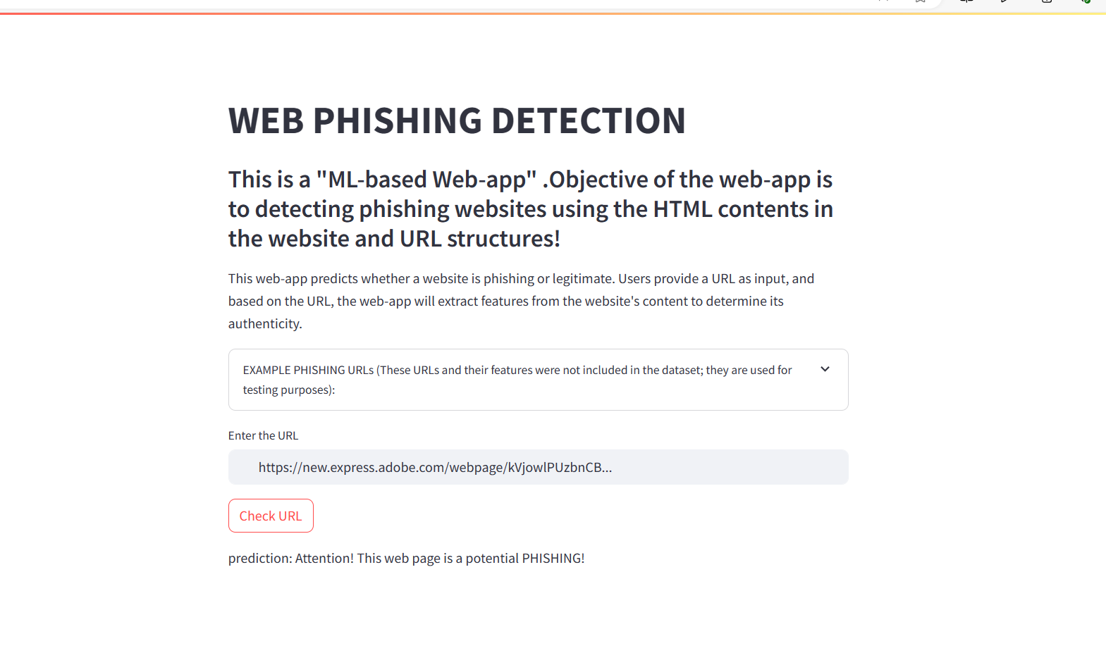
Interface of web-app using streamlit

Slide 14
Preprocessing and Feature Extraction for Prediction URLs:
In addition to training URLs, the system also needed to handle prediction URLs in real-time.
To ensure consistency and reliability, the same preprocessing and feature extraction techniques used for training URLs were applied to prediction URLs.
This involved cleaning, scaling, and encoding the data before passing it through the trained model for inference.

Slide 15
Package and Library Utilization
Package and Library Utilization:
In My project, I have utilized several Python packages and libraries to streamline different stages of the development pipeline, including data preprocessing, feature extraction, model training, evaluation, and visualization. Let's explore the key packages and their roles in My project:
Pandas:
Functionality: Pandas is a powerful data manipulation and analysis library that offers versatile data structures and tools for handling structured data.
Role in the Project: Pandas played a pivotal role in loading, cleaning, and transforming our dataset. It enabled to conduct essential preprocessing tasks such as data cleaning, manipulation, and aggregation efficiently.

Slide 16
NumPy:
Functionality: NumPy is a fundamental library for numerical computing in Python, providing support for multi-dimensional arrays and matrices.
Role in the Project: NumPy facilitated numerical computations and array manipulations, especially during feature extraction and preprocessing. It allowed to perform mathematical operations on our data with ease.
Scikit-learn:
Functionality: Scikit-learn is a comprehensive machine learning library that offers various algorithms for classification, regression, clustering, and more.
Role in the Project: Scikit-learn served as the backbone of our machine learning pipeline. I have utilized its tools for model training, evaluation, hyperparameter tuning, and performance metric calculation.

Slide 17
Matplotlib and Seaborn:
Functionality: Matplotlib is a plotting library for creating static, animated, and interactive visualizations. Seaborn builds on Matplotlib and provides a high-level interface for statistical graphics.
Role in the Project: Matplotlib and Seaborn were instrumental in visualizing our data, model performance, and evaluation metrics. They allowed to generate insightful plots and charts to communicate our findings effectively.
Beautiful Soup:
Functionality: Beautiful Soup is a Python library for web scraping HTML files.
Role in the Project: I utilized Beautiful Soup for web scraping to extract features from URLs. It enabled to parse HTML content and extract relevant information such as links, text, and metadata.

Slide 18
Joblib:
Functionality: Joblib is a library for lightweight pipelining in Python, providing utilities for saving and loading Python objects to disk.
Role in the Project: Joblib was used for persisting trained machine learning models to disk. It allowed to save the model state and reload it for inference without needing to retrain the model.
Requests:
Functionality: Requests is a Python library for making HTTP requests, providing a simpler alternative to urllib.
Role in the Project: Requests simplified the process of fetching data from web servers, enhancing data collection capabilities.

Slide 19
Streamlit:
Functionality: Streamlit is an open-source Python library that simplifies the process of building interactive web applications for data science and machine learning projects.
Role in the Project: Streamlit was instrumental in creating a user-friendly interface for our phishing detection system. It allowed us to develop a web application where users can input URLs and receive predictions on whether they are phishing websites.

Slide 20
Advantages & Disadvantages
Advantages:
Enhanced Security: My project contributes to enhancing online security by effectively detecting phishing websites, thereby reducing the risk of users falling victim to cyber attacks.
Automation: The automation of the phishing detection process using machine learning algorithms allows for quick and efficient identification of potential threats without manual intervention.
User-Friendly Interface: The development of a user-friendly web application using Streamlit makes my solution accessible to a wide range of users, including those without technical expertise.
Customizable: My system can be easily customized and extended to incorporate new features, algorithms, or data sources, allowing for continuous improvement and adaptation to evolving threats.

Slide 21
Disadvantages:
Dependence on Data Quality: The effectiveness of phishing detection system relies heavily on the quality and relevance of the training data. Inaccurate or outdated data may lead to suboptimal performance and false positives/negatives.
Dynamic Nature of Threats: Phishing techniques and tactics evolve rapidly, posing a challenge to static detection models. Continuous monitoring and updating of the system are required to adapt to emerging threats and maintain effectiveness.

Slide 22
Conclusion and Future Directions
Conclusion:
In conclusion, my project has demonstrated the effectiveness of machine learning in detecting phishing websites and enhancing online security. By leveraging web scraping, feature extraction, and model training techniques, we developed a robust solution capable of identifying fraudulent websites with high accuracy.
Future Directions:
Moving forward, there are several avenues for future research and improvement. We could explore additional features, experiment with different machine learning algorithms, and further optimize model's hyperparameters to enhance its performance.
We can additional features to the mode like
javascript based contents etc

Slide 23
THANK YOU

